Slide 1
Event Management for college club
Karishma Mujavar TYC26 Samrudhi Bongale TYC05

Slide 2




Home
ABOUT US
REGISTER/LOGIN
CLUBS
CONTANCT US
WE ARE HERE
EVENT MANAGEMENT FOR COLLEGE CLUBS
🟢 "Manage & Explore College Events Seamlessly!"
🎉 "Never Miss a College Event Again!"
📅 "Your College, Your Events, Your Experience!"
GET STARTED

Slide 3

About Us
Home
REGISTER/LOGIN CLUBS CONTANCT US
Empowering College Clubs & Events with Seamless Management!
We simplify the process of organizing, discovering, and participating in college events, ensuring that students never miss an opportunity to engage, learn, and have fun.
Why Choose Us?
✅ All Events in One Place – Browse & register for upcoming college events effortlessly.
✅ Simplified Club Management – Clubs can organize, promote, and manage their events seamlessly.
✅ Stay Updated – Get real-time notifications & reminders for the events that matter.
✅ Easy Collaboration – Faculty & students can connect and collaborate to create meaningful experiences.
Join Us in Transforming Campus Life!
Be a part of a dynamic college community where events bring people together.
💡 Ready to explore?
GET STARTED

Slide 4

Home
REGISTER/LOGIN
CLUBS
CONTANCT US
LOGIN TO YOUR ACCOUNT
Username :
Email Address :
Password :
Don’t have an account? Sign Up now
LOGIN

Slide 5
Home
REGISTER/LOGIN
CREATE NEW ACCOUNT
name
CLUBS
CONTANCT US
PRN
Password :
Phone number:
name
Email
name
Password
Already have account? LOG IN
SIGN UP

Slide 6






Home
REGISTER/LOGIN
CLUBS
CONTANCT US
CLUBS
SEARCH CLUBS
Team Mavericks is a dynamic student-run organization dedicated to fostering community engagement and social impact
The Entrepreneurship Cell KITCoEK of KIT's College of Engineering (Autonomous), Kolhapur is popularly known as E-Cell KITCoEK
The club emphasizes service projects, leadership development, and community engagement.
Walk With World
“By the Students, For the Students”

Slide 7

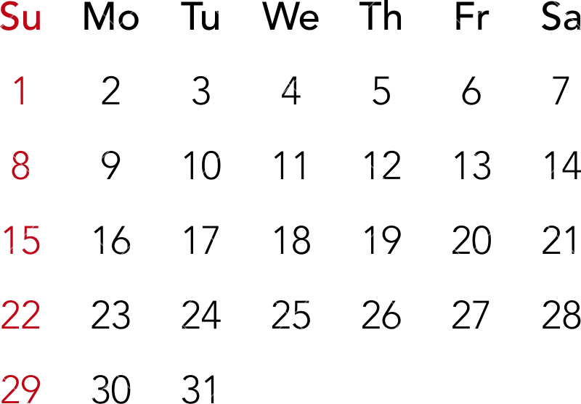
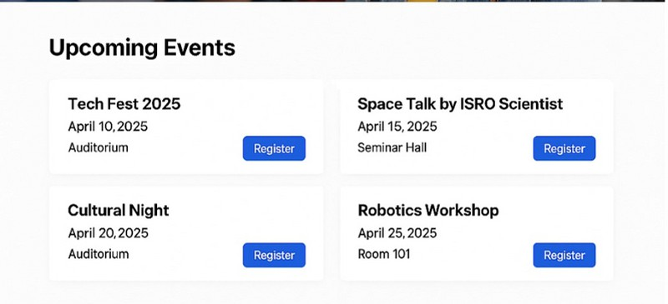
Home
REGISTER/LOGIN
CLUBS
CONTANCT US
Club Events are added to calendar which are visible to users
EVENTS
12
12

Slide 8

Thank You

